Slide 1
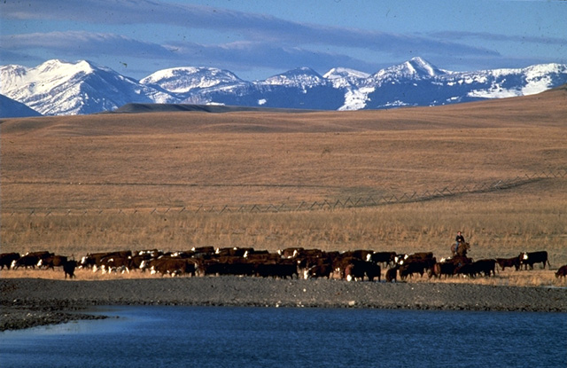
Environmental Community Perspectives on Challenges and Research Needs for the Animal Industries
Suzy Friedman, Staff Scientist
Center for Conservation Incentives at Environmental Defense
Sfriedman@environmentaldefense.org
1875 Connecticut Ave, NW, #600
Washington, DC 20009

Slide 2
Dual Challenges
Research Needs: What are the real gaps in knowledge about animal agriculture and environmental impacts? What are the most pressing issues today?
Communication Needs: How can the agricultural research community better educate the general public about what is known today and which threats are real and which are misperceptions?

Slide 3
Pressing Research Needs: Need for new technologies and approaches
Despite their great importance, the existing suite of conservation practices and technologies are not getting the job done.
Today’s conservation challenges facing livestock and poultry growers are changing and growing too fast for traditional approaches to meet the needs.
Today’s new situations and new forms of raising animals requires new solutions to address water quality, air quality, odors, and public health.
Research into new approaches MUST be taken from the laboratory to demonstration on the farm scale if innovations are to have a real impact.

Slide 4
Pressing Research Needs:
Air Quality
Air quality related to animal agriculture is the most pressing concern without sufficient scientific understanding.
Funds for research and pilot projects focused on water quality and other issues still far exceed the amount focused on air quality. Air quality needs much greater attention.
Urgently need research and data to show what the real problems are and why they happen.
Urgently need research and development of approaches to enable producers to reduce air emissions and odors – focus on the problem AND the solution!

Slide 5
Research Needs: Economics
Biggest challenge in implementing new technologies is economics – solutions are worthless if they are not economically viable.
Research and demonstration projects of new approaches and technologies MUST address the issue of economics.

Slide 6
Research Needs: Energy and Alternative Uses
Need more research into energy production from manure/litter, including the economics and management needs of such systems.
Need more research and demonstration of alternative uses of manure/litter, including alternative methods of application that reduce runoff and volatilization threats.
For both these issues, research projects must address how the new technology or approach fits into the existing farming operation.

Slide 7
Taking Research to the Field
Innovation in the academic research arena does no good, no matter how effective, if those ideas are not transferred to the farm.
Need to significantly enhance technology transfer efforts. Plans and actions to transfer new approaches to the field should be written into EVERY research project focused on agricultural environmental challenges.
Prime example – extensive research on promise of feed management to reduce excess excreted nutrients, but limited transfer to farms, especially within the dairy sector.

Slide 8
Communication Needs
Somehow, a barrier has grown between those in the agricultural world (producers and researchers) and the environmental community and general public.
The lack of effective communication between these two communities often results in an “us versus them” attitude.

Slide 9
Communications Needs
Far too often, research that better defines actual challenges related to animal agriculture does not reach the general public.
Far too often, research and demonstration projects of solutions to environmental challenges for livestock and poultry do not reach the general public.

Slide 10
Communication Needs –
What to do?
Identify and reach out to leaders from key environmental and public health organizations, both national and regional/local in order to establish a relationship.
Personal – especially face-to-face -- communication is key to breaking down the barriers.

Slide 11
Communication Needs –
What to do?
Submit proposals to get on the agenda of conferences and meetings of key environmental, public health, and community organizations.
Share key knowledge about animal agriculture – what the challenges really are, what solutions have been developed, and what progress has been made.

Slide 12
Communication Needs –
What to do?
Hard work lies ahead to tackle this communication issue, but it will pay off.
Human contact, putting a face on an otherwise abstract threat, and sharing essential information have the potential to radically alter the relationship between the general public/environmental community and the agricultural research/production community.

Slide 13
Communication Needs –
What to do?
Invite key contacts in the environmental, public health, and community organizations to visit a farm – meeting a farmer face-to-face and seeing a real operation is an eye opening experience and can help dismantle fears by putting a face on perceived fears.
Be honest! Never try to gloss over real challenges or diminish actual problems related to animal agriculture. Honesty and personal contact are the best ways to develop trust.

